Slide 1
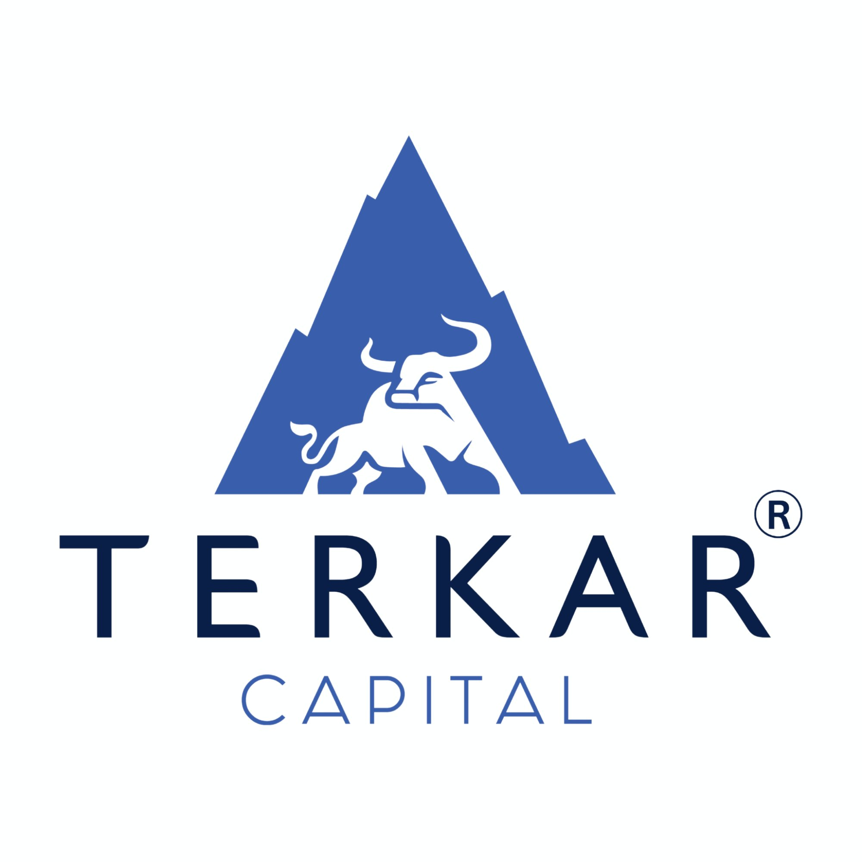
IT Services Industry
Working Capital Management & Financing Guide

Slide 2
IT Services Industry - Overview
Market Size 2024
₹1.37 Lakh Cr
($16.5 Bn)
Growth Rate
6-7% YoY
CAGR
Employment
5.4 Million+
Professionals
Export Share
65%+
of Revenue
India is the world's leading IT outsourcing destination with robust talent pool
Comprises software development, IT consulting, cloud services, cybersecurity, and BPO
Major clients: BFSI (22.5%), Manufacturing, Healthcare, Retail sectors
Hub cities: Bangalore, Hyderabad, Pune, Chennai, NCR, Mumbai
Key technologies: Cloud Computing (33% market share), AI/GenAI, Cybersecurity
Growth drivers: Digital transformation, cloud migration, automation adoption
Competitive advantage: Cost-effective solutions, English proficiency, 24/7 operations
Global Capability Centers (GCCs) growing rapidly - 3.46M workforce by 2030

Slide 3
Operational Process in IT Services
1. Client Acquisition
15-90 days
Lead generation • Proposal & bidding • Contract negotiation
2. Project Planning
7-15 days
Requirement analysis • Team allocation • Work breakdown
3. Development/Delivery
30-180 days
Execution • Quality assurance • Client reviews
4. Invoicing & Payment
45-90 days
Milestone billing • Invoice generation • Payment collection
Note: IT Services have minimal physical inventory. Main working capital need is managing receivables from clients during project delivery cycles.

Slide 4
Key Resources & Inputs
Human Capital (Primary Asset)
Software developers, architects, project managers • Quality assurance testers • DevOps engineers, cloud specialists • Cybersecurity experts • Domain consultants
Technology Infrastructure
Development tools & software licenses • Cloud computing resources (AWS, Azure, GCP) • Servers, workstations, networking equipment • Security tools and antivirus software • Collaboration platforms (Slack, Jira, GitHub)
Office & Operational
Office space and utilities • Internet and communication services • Training and certification programs • Insurance and compliance costs • Marketing and business development expenses

Slide 5
Service Deliverables & Revenue Streams
Application Development & Maintenance
35-40%
Custom software, mobile apps, web portals, legacy modernization
Cloud & Platform Services
30-35%
Cloud migration, managed cloud, DevOps, infrastructure-as-a-service
IT Consulting & Systems Integration
15-20%
Digital transformation, ERP implementation, IT strategy
Managed Security Services
8-12%
Cybersecurity, threat detection, compliance, security audits
Business Process Outsourcing (BPO)
5-10%
Customer support, finance & accounting, HR services, data entry
Emerging Technologies
5-8%
AI/ML solutions, blockchain, IoT development, data analytics

Slide 6
Working Capital Cycle in IT Services
Working Capital Cycle = (Accounts Receivable Days) - (Accounts Payable Days)
Accounts Receivable 45-90 days
Minus Accounts Payable 15-30 days
Net WCC 60-90 days
Time to collect payment from clients after invoice
Time to pay vendors, salaries, infrastructure costs
Actual cash gap that needs financing
IT services have NO inventory component - cash is primarily tied up in receivables
Longer client payment terms (especially international: 60-90 days) create cash gaps
Must pay employee salaries monthly while waiting for client payments
Project-based work means lumpy cash flows - multiple projects completing at once or dry spells
Growth compounds the problem: more projects = more receivables = more working capital needed

Slide 7
Common Mistakes to Avoid
❌ Delayed or Irregular Invoicing
Impact: Cash flow gaps, late payments, poor cash visibility
✓ Solution: Invoice immediately upon milestone completion, automate invoicing
❌ Accepting Long Payment Terms Without Factoring
Impact: 90-120 day receivables drain working capital
✓ Solution: Use invoice discounting/factoring, negotiate shorter terms, ask for advance payments
❌ Poor Receivables Follow-up
Impact: Clients delay beyond terms, bad debts increase
✓ Solution: Dedicated AR team, automated reminders, penalty clauses in contracts
❌ Not Billing in Milestones
Impact: All payment received at project end, long cash cycles
✓ Solution: Structure milestone-based billing (30-60-90 or 40-30-30 models)
❌ Taking Too Many Projects Without WC Planning
Impact: Overcommitted, can't meet payroll during receivables wait
✓ Solution: Match project pipeline with available working capital or arrange credit lines
❌ No Credit Assessment of Clients
Impact: Working with clients who have poor payment history
✓ Solution: Credit checks, advance payment for new clients, bank guarantees for large contracts

Slide 8
Standard Working Capital Cycle: IT Services
Standard Working Capital Cycle
60-90 days
~4-6 Annual Cycles
Component
Typical Days
Notes
Accounts Receivable (Domestic)
45-60 days
Net 30 to Net 45 terms common
Accounts Receivable (International)
60-90 days
Net 60 standard for US/EU clients
Accounts Payable
15-30 days
Employee salaries, vendor payments
Net Working Capital Cycle
60-90 days
Cash gap period requiring financing
📌 Key Insight: IT companies need working capital financing to bridge the 60-90 day gap between paying employees/vendors and receiving client payments. This is especially critical during growth phases when taking on more projects simultaneously.

Slide 9
Customer Credit Periods & Payment Terms
Domestic Corporate Clients
Net 30 - Net 45 days
45 days average
💡 Large enterprises may stretch to 60 days
International Clients (US/EU)
Net 60 - Net 90 days
75 days average
💡 Standard terms for offshore development
SME & Startup Clients
Net 30 - Net 45 days
30-40 days average
💡 Sometimes require advance payment or milestones
Government & PSU Projects
60 - 120 days
90+ days average
💡 Slow but secure; requires patience
Fixed-Price Projects
Milestone-based
Varies
💡 Typically: 30% advance, 40% on delivery, 30% post-deployment
Time & Material (T&M) Contracts
Monthly billing
30-45 days
✓ Best Practice: Structure contracts with milestone-based payments (e.g., 30-40-30) to reduce working capital strain and improve cash flow predictability.
💡 Better cash flow as billing is frequent

Slide 10
Industry Scope & Growth Opportunities
🚀 Growth Drivers
💡 Emerging Opportunities
Cloud adoption accelerating at 23.4% CAGR (₹17.8K Cr by 2027)
GenAI & AI integration creating new service lines and revenue streams
Digital transformation investments surging post-pandemic across all sectors
Global Capability Centers (GCCs) expanding - 3.46M jobs by 2030
5G rollout driving demand for IoT, edge computing, and smart solutions
Cybersecurity services growing due to increasing threat landscape
India's Global Innovation Index rank improved to 39th (2024)
AI-as-a-Service: Offering GenAI solutions to enterprises
Industry Cloud Solutions: Verticalized offerings for BFSI, Healthcare, Retail
Cybersecurity Services: Managed detection & response, zero-trust architecture
Data Engineering & Analytics: Building data lakes, real-time analytics platforms
Low-Code/No-Code Development: Faster time-to-market for clients
Sustainability Tech: Carbon tracking, ESG reporting solutions
Web3 & Blockchain: Decentralized applications, smart contracts
📈 Market Projections
India IT Services market expected to reach ₹2.07 Lakh Cr ($25 Bn) by 2030 growing at 6-7% CAGR. Cloud and AI services to dominate with 40%+ market share.

Slide 11
Industry Threats & Challenges
⚠️ Talent Attrition & Wage Inflation
Annual attrition 15-20%; GCC expansion driving 15-20% wage premiums; skilled talent shortage in AI/Cloud
✓ Reskilling programs, flexible work models, competitive compensation
⚠️ Global Economic Uncertainty
Recession fears in US/EU leading to cautious IT spending and budget cuts
✓ Diversify client base, focus on cost-optimization services, pivot to emerging markets
⚠️ Currency Fluctuations
Rupee volatility affects export realizations and profitability margins
✓ Currency hedging, natural hedging through local expenses, pricing adjustments
⚠️ Increased Competition
Competition from Vietnam, Philippines, Eastern Europe; pricing pressure from onshore providers
✓ Move up value chain, specialize in niche areas, highlight quality over cost
⚠️ Technology Obsolescence
Rapid tech changes (AI, Cloud) require constant upskilling; legacy skills becoming redundant
✓ Continuous learning culture, partnerships with tech giants, R&D investment
⚠️ Client Concentration Risk
Heavy dependence on few large clients (top 5 clients = 40-50% revenue for many firms)
✓ Diversify client portfolio, expand into new industries, build recurring revenue streams
⚠️ Data Privacy & Compliance
GDPR, Data Protection Act compliance costs; cybersecurity threat exposure
✓ Invest in certifications (ISO 27001, SOC 2), robust security infrastructure
⚠️ Payment Delays & Bad Debts
Extended receivables (90+ days), client bankruptcies, disputed invoices
✓ Credit insurance, advance payments, invoice factoring, strong contracts

Slide 12
How Terkar Capital Can Help IT Services Companies
Terkar Capital understands the unique working capital challenges of IT services - managing 60-90 day receivables while meeting monthly payroll and operational expenses. We provide fast, flexible financing solutions tailored to your cash flow cycles.
Unsecured Working Capital Loans
Secured Working Capital Loans
Quick funding up to ₹5 Cr without collateral for operational expenses, payroll, vendor payments
Higher limits (₹5-100 Cr+) against receivables, property, or FDs for larger requirements
Invoice Discounting & Factoring
Bill Discounting
Convert 45-90 day receivables into immediate cash at competitive rates (12-18% PA)
Get paid immediately on invoices - we collect from your clients
LC Discounting
CGTMSE Loans
Financing against confirmed export LCs for international projects
Collateral-free loans up to ₹5 Cr under government-backed scheme for MSMEs
Why Choose Terkar Capital?
✓ 7-10 Day Disbursement | ✓ Rates from 9% PA | ✓ 15+ Years Experience | ✓ 400+ Corporate Clients | ✓ Flexible Repayment Aligned with Your Cash Flows

Slide 13
Partner with Terkar Capital
Empowering IT Services Companies with Smart Working Capital Solutions
www.terkarcapital.com
📍 Pune: Castle Eleganza, Erandwane, Pune - 411004
📍 Mumbai: The Capital, Level 7, BKC, Mumbai - 400051

